Slide 1
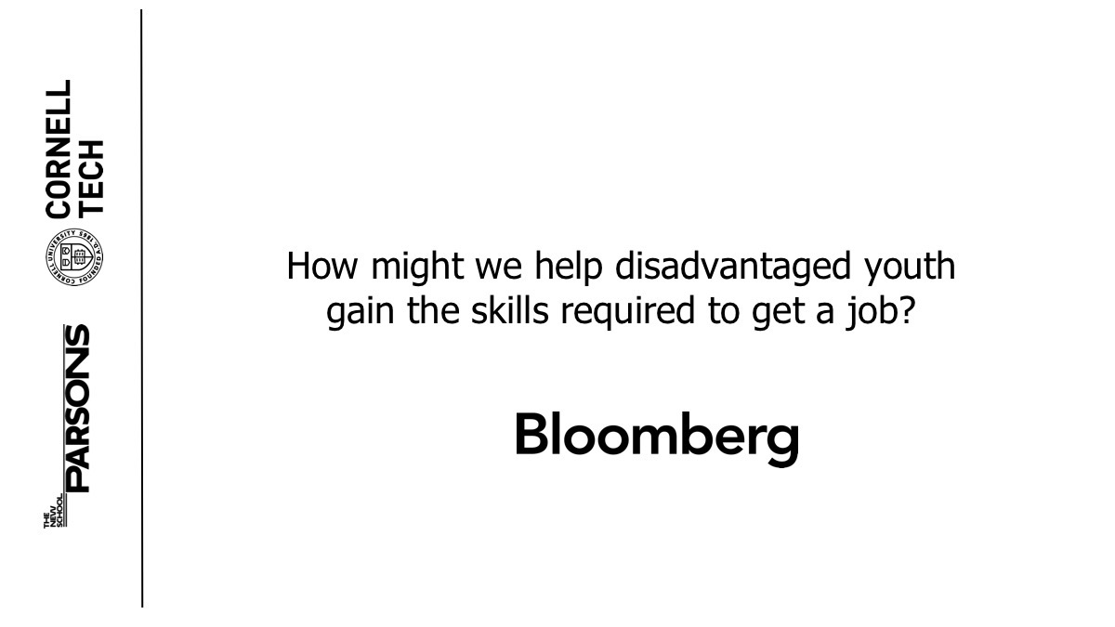


How might we help disadvantaged youth gain the skills required to get a job?

Slide 2


Ana, age 21
2nd generation immigrant
Low income family
High School Graduate
Motivated to learn to work in technology
“I would be great to have someone to verify is this the right move, should I be doing this… just ask for advice”
Notes:
Ultimately, this is about Ana… a young motivated girl from a low income family. Let us show a very short clip about some of her pain points.

Slide 4
RESEARCH INSIGHTS
73% of professionals considered mentorship to be instrumental in their careers
70% of youth without mentoring history report that failed to find professionals to mentor them
Personal Interaction leads to better engagement, learning and participation
Assistance & Guidance are needed for mentee and mentor
Notes:
As you can see, youths live in a world that doesn’t provide them with the resources they need to succeed. They don’t have the opportunity to meet with professionals that can inspire them to learn and improve their skills and even when they are able to find a mentor, it can be a very intimidating and nerve-wracking experience, whether it be about knowing what to ask or how to interact.

Slide 5
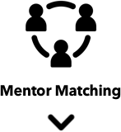





Slide 6
DEMO
Notes:
Website: because in our research we found that many youth at a disadvantage don’t have smartphones and many even access electronic devices through their libraries, schools, etc.
Matching Algorithm: by taking the interests and skills of the mentees and matching them to the mentors
Agenda: engages mentee before the meeting start to think about topics of conversation and questions to ask. Keeps meeting on track
Video: helps preserve the personal interaction that is important in mentorship experience, while still making it easy on the mentors to set their own time and mentor anytime, anywhere.
QuestionBot: aids in suggesting questions to mentor and mentee to keep the conversation relevant.
Assignments: ensures continuity with mentor, as well as engagement and commitment and furthers learning experience
Meeting 3x with mentor: ensure continuity which we believe it is important for both sides.
Gamification: as you go through the program and you continue meeting with your mentor which ensure continuity, you can then unlock the opportunity to meet with another mentor, or even the mentor can recommend you to a specific mentor in order to expand the mentee’s network.
You can also unlock access to exclusive events in which the mentor would also invite you, which also helps in expanding the mentee’s network

Slide 7
NEXT STEPS
Iterate on the UI
Continue building website to match the UX design
Continue testing with users for additional validation
Michael MBA
Mike
CS
Vincent
CS
Yi
Design
Andy
CM

Slide 8
QUESTIONS?
Michael MBA
Mike
CS
Vincent
CS
Yi
Design
Andy
CM

Slide 9



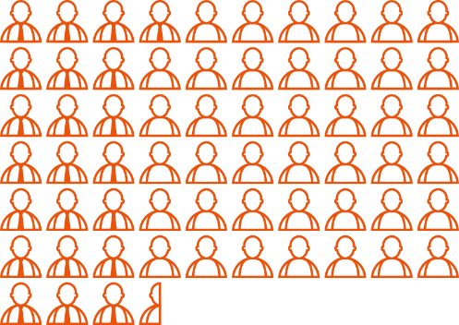
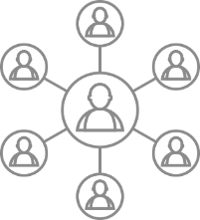


Interests
Skills
Matching Mentors
Choose mentor & set up Agenda
Meet with Mentor
(Online Video & QuestionBot)
Unlock other Mentors & Exclusive Events to Expand your Network
Review assignment with Mentor
Complete Assignment
Meet at least 3 times
Notes:
Our mission is to democratize access to mentors through an engaging online platform, where we combine the power of human, personal interaction and leverage technology to aid these human/personal interactions rather than replace them. Our product aims to the tools and resources to have an easy, engaging and effective mentorship experience with leaders in the tech industry.
Easy to access, because it is accessible to all, no-entry barriers
Engaging by using online video meetings and a QuestionBot to aid for better engagement in asking questions
Effective by giving assignments to mentees to complete and as such, ”learning by doing”

